Slide 1

Java 8
Getting into streams, method references
and lambda functions

Slide 2
Summary
Introduction
Lets focus.
Overview from Lambdas, Method References and Stream API.
Lambda, Method Reference and Stream API.
Q&A

Slide 3
Introduction
Java 8 (or JDK 1.8), is the current release of the Java programming language that was released on March 18 of 2014, in this release, Java provided new features like functional programming, a new JavaScript Engine, new APIs for streaming, new APIs for date time manipulation, etc.

Slide 4
Lets focus on!
Ok, Java 8 has a lot of new and cool stuff, but we are going to focus in just three of this new features, Lambdas, Method Reference and the Stream API, we are going to review how they can improve the way we write our code and how to incorporate them in our code.

Slide 5
Overview from Lambda, Method reference and Streams.
Lambda Expressions: they are anonymous functions, that can recibe any parameters
(parameter1, parameter2,…parametern -> /*what I do*/);
Method reference: is an easy way to call existent methods by their name in a lambda expression.
Collection.forEach(System.out::pritnln):
Streams: A new way to work with collection that was include in this new version of Java that can give us a “free” parallelism included in this API.

Slide 6
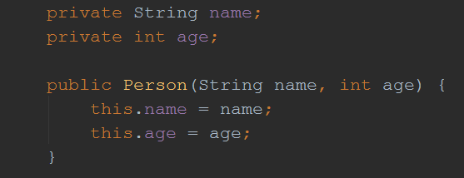
Lambda, Method Reference and Stream API.
So, lets see the context of what we are going to do, we have a Person class, that have the next attributes and constructor.
Also this has his own setters and getters and his toString() function.

Slide 7
Lambda, Method Reference and Stream API.
So, we already know the Person class, but what are the objectives to do whit this?
Print every person on the list using toString method.
Sort them by Age.
Filter for the people who has more than 21 years.
Get the sum of all ages of the people on the list.
And, this are just a few examples of what we can do, if we really want to, we can do a lot of more stuff with this new features.

Slide 8
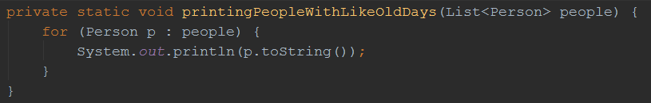
Lambda, Method Reference and Stream API.
So for printing, if we are using a version below Java 8, we usually will do something like this for get this problem solved
And this code can be “reduced” using a lambda expression like…

Slide 9

Lambda, Method Reference and Stream API.
With this, we get a object person, that will be of the same type as the objects of the list Person, so we can access to the Person methods and call the method, toString(), to print the data from every person in the list.
Also, we can use a method reference to reduce this code a lot more, and the new code will be like this…

Slide 10

Lambda, Method Reference and Stream API.
With this method reference, we access to the toString() method by just using (System.out::println)
So this is for printing a collection, let see how we can sort the collection by age!

Slide 11
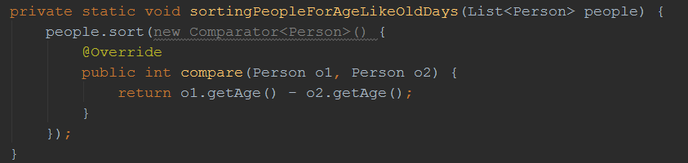
Lambda, Method Reference and Stream API.
The classic way we use to sort a collection with Collection.sort()
Where we have to add a new Comparator<T> and @Override the compare method, to get some like this
Remember the “new Comparator<Person>()” we’ll use it later.

Slide 12

Lambda, Method Reference and Stream API.
So, we’ll get the use of a some Java 8 magic to do all that job, in one line.
So, whit this, we are using the Comparator and using a “forced” compare, using comparingInt(…), to avoid using the natural compare of the class, and using the method reference to pass what we are going to compare to sort the collection in “(Person::getAge)”, so with this, we can reduce all that job.

Slide 13
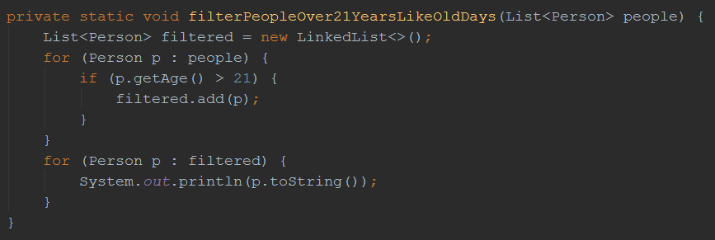
Lambda, Method Reference and Stream API.
With the print, and the sort done, lets start doing a filter by age.
So this is how we are doing before Java 8 a simple filter.

Slide 14
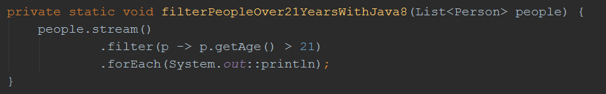
Lambda, Method Reference and Stream API.
Lets see how this can be done with the Java 8 Stream API and Lambda methods
people.stream(), make our collection a Java 8 stream.
.filter(p->p.getAge()>21), give us the utility of the lambda methods, to filter any Person “p” object in the list, that has the age greater than 21.

Slide 15
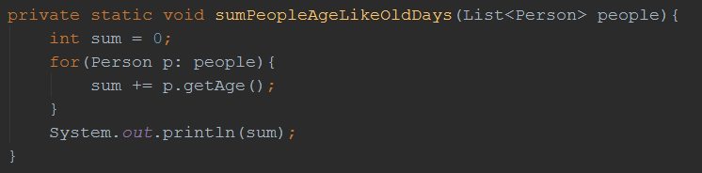
Lambda, Method Reference and Stream API.
So we already done practically al of the job, so just the last one remains, lets get the addition of all the ages in the list.
I think, this is how all of us has done before:

Slide 16

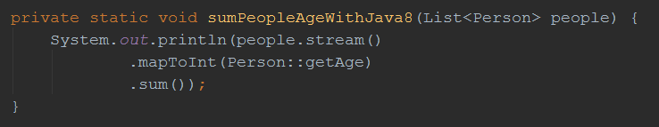
Lambda, Method Reference and Stream API.
Lets see how we can don’t this in less with the power of the Streams API
But this is kind of ugly so, a tip for the best practices, and make this code easier to read using new lines.

Slide 17
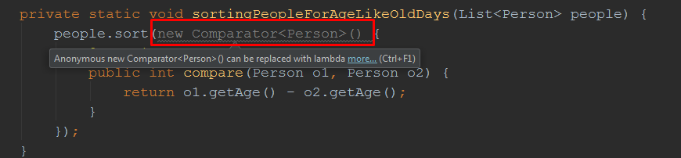
IntelliJ Idea
Do you remember, that one part of code I told you to take a note, IntelliJ Idea, can do a lot of stuff on that, and make some implementations easier… a lot easier.
So if we press Alt + Enter, IntelliJ start doing magic, and modify our code to use the new Java 8 Stuff, IntelliJ automatically offer the option to replace this code with lambda methods.

Slide 18

IntelliJ Idea
So there is our new “sort” with lambdas automatically generated by IntelliJ, but there is more recommendations by IntelliJ.
If we press Alt + Enter again, IntelliJ just make our code like the same I’d show you before.

Slide 19
Questions n Answers

Slide 20
Thanks!

